Slide 1
Maize Leaf Disease Classification using Deep Learning
Presented by: ALVIN KIPTOO
Ngao Labs Foundation
Team White
Date: 4 December 2025

Slide 2
The Global Challenge What is the Problem?
Crop diseases and pests severely threaten food security in Kenya.
Maize diseases lead to significant yield losses, directly impacting farm income and regional food supply.
Why Maize is Important
Maize is the staple crops in Kenya.
It serves as a primary source of food and livestock feed across Kenya and even globally.
Why does Automated Detection Matters?
Traditional diagnosis is slow, manual, and requires expert knowledge.
Automated detection provides farmers with fast, accurate, and early identification, enabling timely intervention.

Slide 3
KEY PROJECT GOALS
Detect Maize Leaf Diseases Automatically
Develop a robust Deep Learning model to identify various pathologies from leaf images.
Improve Accuracy and Speed
Leverage state-of-the-art Convolutional Neural Networks (CNNs) to surpass traditional diagnostic methods in performance.
Assist Farmers with Early Identification
Create a tool that can be deployed for real-time monitoring and early warning, minimizing crop loss.

Slide 4
MAIN & SPECIFIC OBJECTIVES
Main Objective
To develop a deep-learning-based model to detect and classify maize leaf diseases.
Specific Objectives
Build a clean maize disease image dataset.
Apply EfficientNet for feature extraction.
Train and evaluate a deep learning classification model.
Deploy the model using a Streamlit web interface.

Slide 5
MULTI-CLASS DATASET
Statistic | Value
Source | Collected Images (Kaggle)
Total Images | 5,287 files
Image Size | 224 x 224 pixels
Total Classes | 7 Disease and Health Categories
Link to Kaggle Dataset:
https://www.kaggle.com/datasets/nirmalsankalana/crop-pest-and-disease-detection?select=Cashew+anthracnose

Slide 6
Class distribution (7 classes)
CLASS NAME | TRAINING COUNT
Maize leaf spot | 979 (Largest Class)
Maize leaf blight | 782
Maize streak virus | 772
Maize leaf beetle | 750
Maize grasshoper | 547
Maize fall armyworm | 236
Maize healthy | 164 (Smallest Class)

Slide 7
METHODOLOGY
DEEP LEARNING ARCHITECTURE

Slide 8
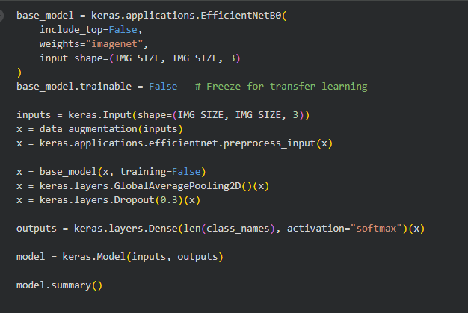
Model Architecture
Using EfficientNetB0 (transfer learning)
Architecture Highlights:
Pretrained on ImageNet
Uses compound scaling
Very efficient on mobile/edge devices
Added custom classifier head:
GlobalAveragePooling2D
Dense(256, relu)
Dropout(0.5)
Dense(3, softmax)

Slide 9
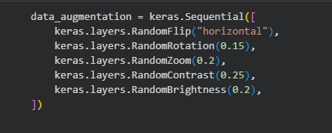
Image Preprocessing & Augmentation
Preprocessing:
Image resizing to 224x224 and normalization.
Strong Data Augmentation:
Applied random transformations to artificially expand the dataset and improve model robustness.
Horizontal Flip
Random Rotation
Random Zoom
Random Contrast & Brightness

Slide 10
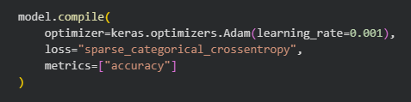
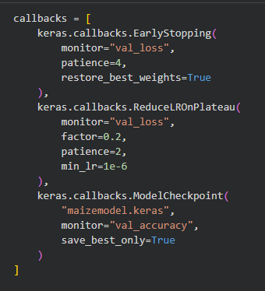
Training details
Optimizer: Adam
Loss Function: Sparse Categorical Crossentropy
Callbacks:
Early Stopping (patience=4)
ReduceLROnPlateau (patience=2, factor=0.2)

Slide 11
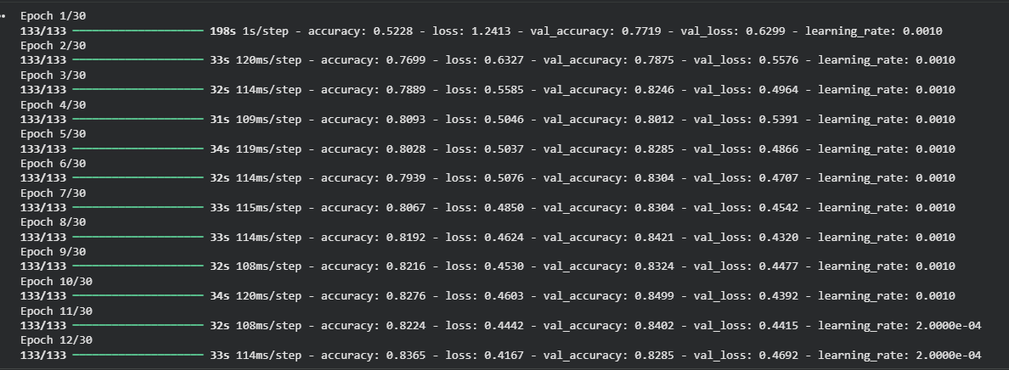





EVALUATION METRICS
Final Performance Highlights
Best Validation Accuracy: 84.99%
Best Validation Loss: 0.4320
The model was trained for 12 epochs before callbacks halted the process.

Slide 12
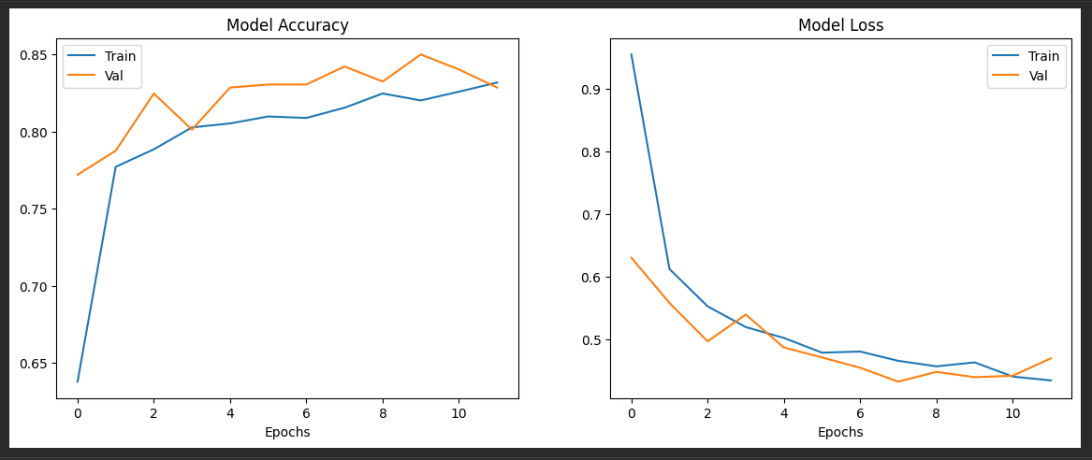
Evaluation visuals
Accuracy & Loss Graphs: Show training and validation curves, demonstrating convergence and generalization ability.

Slide 13
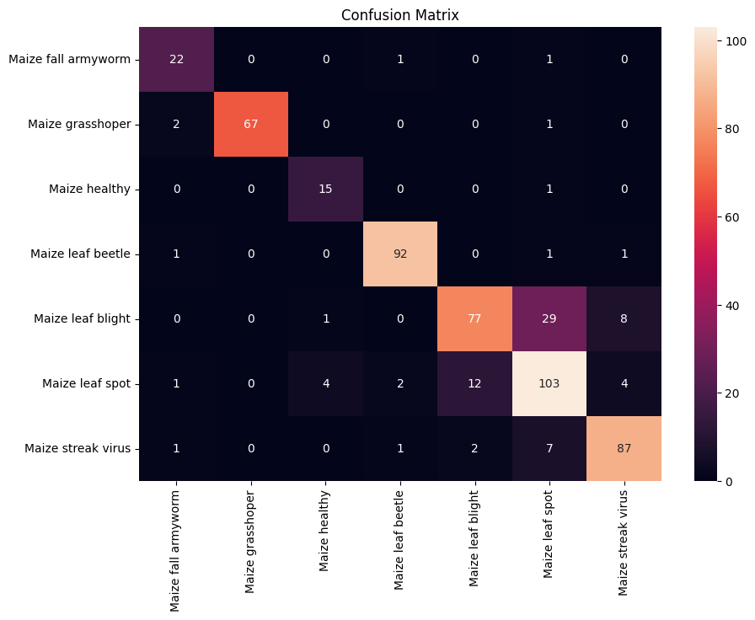
Confusion Matrix
Generated to show per-class prediction quality and identify misclassified samples.

Slide 14
MODEL WORKFLOW & prediction
A farmer captures an image of a maize leaf using a smartphone.
The image is uploaded to the system, automatically resized to 224x224, and normalized.
The pre-trained EfficientNetB0 model analyzes the processed image.
Model predicts and displays:
Disease class
Confidence score
Shows uploaded image
Very lightweight for mobile/desktop use

Slide 15
Challenges & solution
Challenge | Impact | Solution Implemented
Class Imbalance | The imbalance (e.g., Healthy: 164 vs. Leaf Spot: 979) can bias the model toward majority classes. | Strong Data Augmentation was applied to increase diversity and quantity of samples for minority classes.
Limited Dataset Size | Can lead to overfitting, resulting in poor performance on new, unseen data. | Transfer Learning with EfficientNetB0 was used to leverage features learned from a massive dataset (ImageNet).
Initial Low Accuracy | Early training runs showed slow improvement and high loss. | Optimization of hyperparameters, including using Adam optimizer and ReduceLROnPlateau callback to fine-tune the learning process.

Slide 16
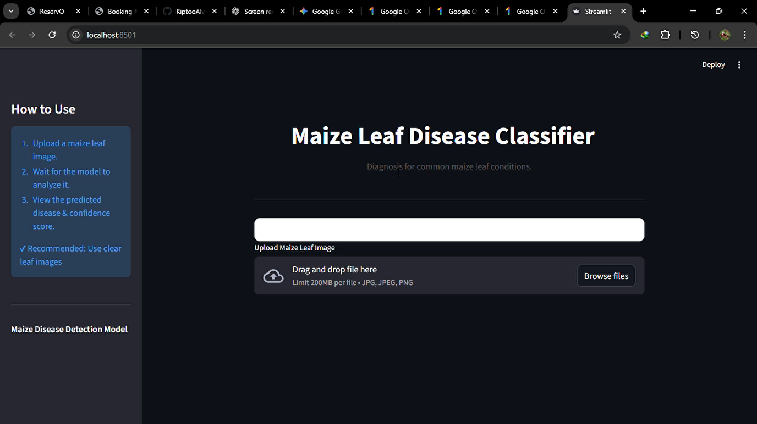
DEmo

Slide 17
Future work
Short-Term Goals
Deployment: Deploy the model as a user-friendly mobile application or web app for immediate access by farmers.
Model Refinement: Fine-tune the EfficientNet layers to further boost overall accuracy and F1-scores.
Long-Term Vision
Add More Diseases: Expand the classification to include a wider range of maize diseases, pests, and nutrient deficiencies.
Integrate with IoT/Drones: Integrate the model with drone or IoT-enabled field monitoring systems for large-scale, automated field scanning and precision agriculture.
Actionable Advice: Develop a system to provide customized treatment recommendations based on the detected disease.

Slide 18
Summary & impact
Summary of Achievements
Successfully implemented a Deep Learning pipeline for multi-class maize leaf disease classification.
Achieved a high Validation Accuracy of ~85% using Transfer Learning with EfficientNetB0.
The model can classify 7 distinct leaf conditions.
Model’s Potential Impact
This project provides a powerful, scalable tool that can contribute directly to:
Increased Crop Yield: By enabling rapid and accurate disease identification.
Reduced Costs: By minimizing the use of unnecessary fungicides and pesticides.
Enhanced Food Security: By protecting a vital global staple crop from widespread failure.

Slide 19
THE END!
THANK YOU
ANY QUESTION?

